Slide 1
A Far Cry from Africa
Shreya Shah (1740855)
Ben Scaria (1740869)
Ritivk Goenka (1740817)
Notes:
Are your classroom colors different than what you see in this template? That’s OK! Click on Design -> Variants (the down arrow) -> Pick the color scheme that works for you!
Feel free to change any “You will…” and “I will…” statements to ensure they align with your classroom procedures and rules!

Slide 2
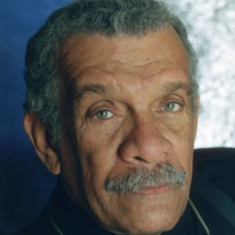
About the poet
Derek Walcott
Born in January 23rd, 1930 in the Eastern Caribbean
Island of St. Lucia.
Love for English language and African roots.
Bagged numerous awards and accolades.
Nobel Prize winner.

Slide 3
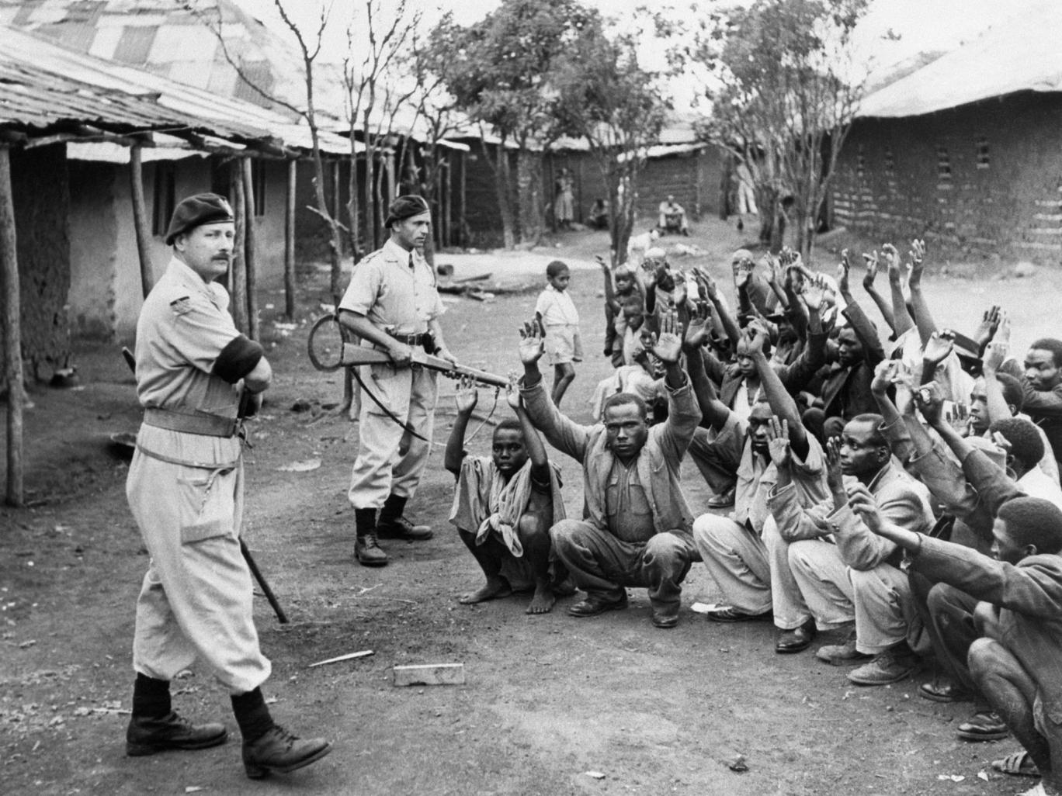
Introduction
Post - colonial poetry.
Colonization by whites.
Mau Mau Uprising in Kenya in mid 1950s.
Conveys poets ambivalent feelings.
Opening setting of the poem – bloodshed in African territory.

Slide 4
Title of the Poem
Ambiguous title - Is the author saying that because he lives on Santa Lucia, an island far away from Africa, he could not hear the screams of the fallen victims of native Africans or was it his cry , which had to travel long distance to reach African shores?
Or ironic ?
The expression ’a far cry’ means that something is quite different from what you had expected. Had the author this ideal image of Africa and its deep culture only to be disappointed by the current reality of the situation there?

Slide 5
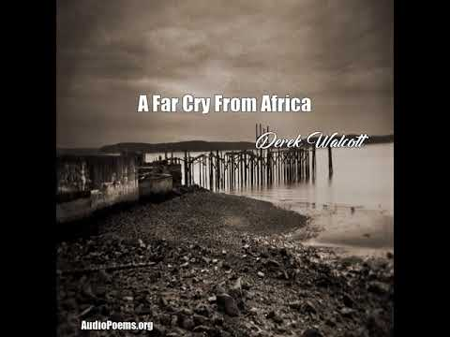
Summary

Slide 6
Stanza 1
Setting- African mainland
Kikuyu tribe are described as flies who are blood thirsty and revengeful.
Landscape littered with corpses.
Whites referred to as worms that reigns in the setting of decaying human flesh.
Where is the humanity in ALL THIS?
The actions of both cannot be justified, as it would mean nothing to the white child who has been murdered
Savages are compared to Jews whose life is worthless and expendable.

Slide 7
Stanza 2
Opening lines paint a detailed picture of typical hunt
Natives are compared to Ibis bird – The native birds of Africa who were driven out of their mainland.
Animals kill for survival
But humans kill to prove superiority and to seek divinity
Whites declaration of peace has a conspiracy lurking to it

Slide 8
Stanza 3
Personification of brutish necessity as it wipes its hand on a napkin – Napkins are white but the cause being dirty.
‘a waste of our compassion’ – compassion being wasted into meaningless death
‘blood of both’ – divided because of his blood ties to both parties.
Walcott is sickened by the conduct pf Mau Mau tribes as well as Englishmen
Walcott will surrender neither Africa nor England.

Slide 9
Themes
Split identity , Anxiety, Isolation, Cruelty, Violence and Love are the major themes.
Title of the poem – Idiom.
Religious symbolism to investigate African life
“corpses” & “paradise”.
Use of metaphors in the poem
“colonel of carrion”
“corpses are scattered through a paradise”

Slide 10
THANK YOU

